Slide 1
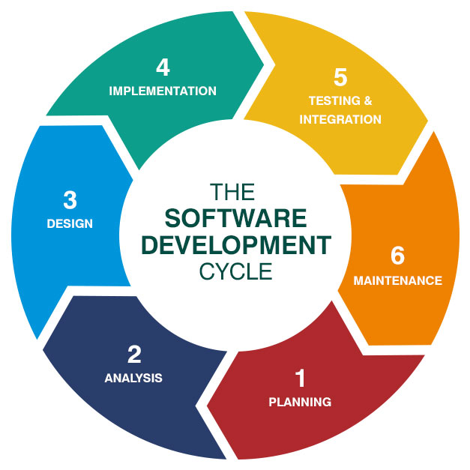
Chapter 3
Software Process and Other Models
Assit.prof. Juthawut Chantharamalee
Curriculum of Computer Science
Faculty of Science and Technology, Suan Dusit University

Slide 2
Outline of this presentation
1. Software process models
2. Process iteration
3. Software specification
4. Software design and implementation
5. Software validation
6. Software evolution
7. Automated process support

Slide 3
The software process
A structured set of activities required to develop a software system
  Specification
  Design
  Validation
  Evolution
A software process model is an abstract representation of a process. It presents a description of a process from some particular perspective

Slide 4
Generic software process models
1. The waterfall model
  Separate and distinct phases of specification and development
2. Evolutionary development
  Specification and development are interleaved
3. Formal systems development
  A mathematical system model is formally transformed to an implementation
4. Reuse-based development
  The system is assembled from existing components

Slide 5
Waterfall model

Slide 6
Waterfall model phases
1. Requirements analysis and definition
2. System and software design
3. Implementation and unit testing
4. Integration and system testing
5. Operation and maintenance
The drawback of the waterfall model is the difficulty of accommodating change after the process is underway

Slide 7
Waterfall model problems
1. Inflexible partitioning of the project into distinct stages
2. This makes it difficult to respond to changing customer requirements
Therefore, this model is only appropriate when the requirements are well-understood

Slide 8
Evolutionary development
Exploratory development
  Objective is to work with customers and to evolve a final system from an initial outline specification. Should start with well-understood requirements
Throw-away prototyping
  Objective is to understand the system requirements. Should start with poorly understood requirements

Slide 9
Evolutionary development

Slide 10
Evolutionary development
Problems
  Lack of process visibility
  Systems are often poorly structured
  Special skills (e.g. in languages for rapid prototyping) may be required
Applicability
  For small or medium-size interactive systems
  For parts of large systems (e.g. the user interface)
  For short-lifetime systems

Slide 11
Formal systems development
Based on the transformation of a mathematical specification through different representations to an executable program
Transformations are ‘correctness-preserving’ so it is straightforward to show that the program conforms to its specification
Embodied in the ‘Cleanroom’ approach to software development

Slide 12
Formal systems development

Slide 13
Formal transformations

Slide 14
Formal systems development
Problems
  Need for specialised skills and training to apply the technique
  Difficult to formally specify some aspects of the system such as the user interface
Applicability
  Critical systems especially those where a safety or security case must be made before the system is put into operation

Slide 15
Reuse-oriented development
Based on systematic reuse where systems are integrated from existing components or COTS (Commercial-off-the-shelf) systems
Process stages
  Component analysis
  Requirements modification
  System design with reuse
  Development and integration
This approach is becoming more important but still limited experience with it

Slide 16
Reuse-oriented development

Slide 17
Process iteration
System requirements ALWAYS evolve in the course of a project so process iteration where earlier stages are reworked is always part of the process for large systems
1. Iteration can be applied to any of the generic process models
2. Two (related) approaches
  Incremental development
  Spiral development

Slide 18
Incremental development
Rather than deliver the system as a single delivery, the development and delivery is broken down into increments with each increment delivering part of the required functionality
1. User requirements are prioritised and the highest priority requirements are included in early increments
2. Once the development of an increment is started, the requirements are frozen though requirements for later increments can continue to evolve

Slide 19
Incremental development

Slide 20
Incremental development advantages
Customer value can be delivered with each increment so system functionality is available earlier
Early increments act as a prototype to help elicit requirements for later increments
Lower risk of overall project failure
The highest priority system services tend to receive the most testing

Slide 21
Extreme programming
New approach to development based on the development and delivery of very small increments of functionality
Relies on constant code improvement, user involvement in the development team and pairwise programming

Slide 22
Spiral development
Process is represented as a spiral rather than as a sequence of activities with backtracking
Each loop in the spiral represents a phase in the process.
No fixed phases such as specification or design - loops in the spiral are chosen depending on what is required
Risks are explicitly assessed and resolved throughout the process

Slide 23
Spiral model of the software process

Slide 24
Spiral model sectors
Objective setting
  Specific objectives for the phase are identified
Risk assessment and reduction
  Risks are assessed and activities put in place to reduce the key risks
Development and validation
  A development model for the system is chosen which can be any of the generic models
Planning
  The project is reviewed and the next phase of the spiral is planned

Slide 25
Software specification
The process of establishing what services are required and the constraints on the system’s operation and development
Requirements engineering process
  Feasibility study
  Requirements elicitation and analysis
  Requirements specification
  Requirements validation

Slide 26
The requirements engineering process

Slide 27
Software design and implementation
The process of converting the system specification into an executable system
Software design
  Design a software structure that realises the specification
Implementation
  Translate this structure into an executable program
The activities of design and implementation are closely related and may be inter-leaved

Slide 28
Design process activities
1. Architectural design
2. Abstract specification
3. Interface design
4. Component design
5. Data structure design
6. Algorithm design

Slide 29
The software design process

Slide 30
Design methods
Systematic approaches to developing a software design
The design is usually documented as a set of graphical models
Possible models
  Data-flow model
  Entity-relation-attribute model
  Structural model
  Object models

Slide 31
Programming and debugging
Translating a design into a program and removing errors from that program
Programming is a personal activity - there is no generic programming process
Programmers carry out some program testing to discover faults in the program and remove these faults in the debugging process

Slide 32
The debugging process

Slide 33
Software validation
Verification and validation is intended to show that a system conforms to its specification and meets the requirements of the system customer
Involves checking and review processes and system testing
System testing involves executing the system with test cases that are derived from the specification of the real data to be processed by the system

Slide 34
The testing process

Slide 35
Testing stages
1. Unit testing
  Individual components are tested
2. Module testing
  Related collections of dependent components are tested
3. Sub-system testing
  Modules are integrated into sub-systems and tested. The focus here should be on interface testing
4. System testing
  Testing of the system as a whole. Testing of emergent properties
5. Acceptance testing
  Testing with customer data to check that it is acceptable

Slide 36
Testing phases

Slide 37
Software evolution
Software is inherently flexible and can change.
As requirements change through changing business circumstances, the software that supports the business must also evolve and change
Although there has been a demarcation between development and evolution (maintenance) this is increasingly irrelevant as fewer and fewer systems are completely new

Slide 38
System evolution

Slide 39
Automated process support (CASE)
Computer-aided software engineering (CASE) is software to support software development and evolution processes
Activity automation
  Graphical editors for system model development
  Data dictionary to manage design entities
  Graphical UI builder for user interface construction
  Debuggers to support program fault finding
  Automated translators to generate new versions of a program

Slide 40
Case technology
Case technology has led to significant improvements in the software process though not the order of magnitude improvements that were once predicted
  Software engineering requires creative thought - this is not readily automatable
  Software engineering is a team activity and, for large projects, much time is spent in team interactions. CASE technology does not really support these

Slide 41
CASE classification
Classification helps us understand the different types of CASE tools and their support for process activities
1. Functional perspective
  Tools are classified according to their specific function
2. Process perspective
  Tools are classified according to process activities that are supported
3. Integration perspective
  Tools are classified according to their organisation into integrated units

Slide 42
Functional tool classification

Slide 43
Activity-based classification

Slide 44
CASE integration
1. Tools
  Support individual process tasks such as design consistency checking, text editing, etc.
2. Workbenches
  Support a process phase such as specification or design, Normally include a number of integrated tools
3. Environments
  Support all or a substantial part of an entire software process. Normally include several integrated workbenches

Slide 45
Tools, workbenches, environments

Slide 46
Key points
Software processes are the activities involved in producing and evolving a software system. They are represented in a software process model
General activities are specification, design and implementation, validation and evolution
Generic process models describe the organisation of software processes
Iterative process models describe the software process as a cycle of activities

Slide 47
Key points
Requirements engineering is the process of developing a software specification
Design and implementation processes transform the specification to an executable program
Validation involves checking that the system meets to its specification and user needs
Evolution is concerned with modifying the system after it is in use
CASE technology supports software process activities

Slide 48

Chapter 1 : The End (Any Question?)

